Slide 1

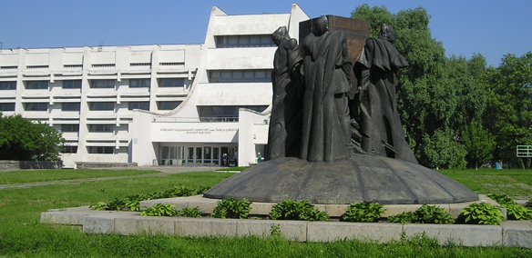


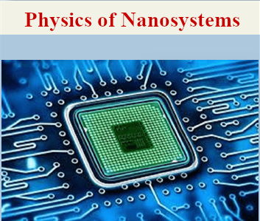
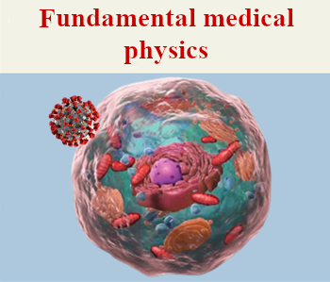
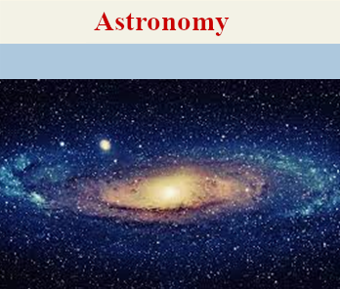
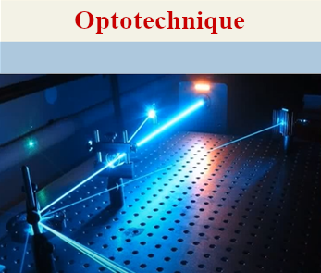
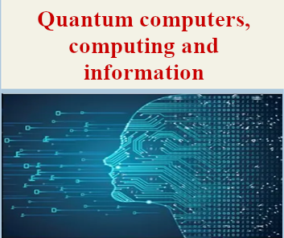
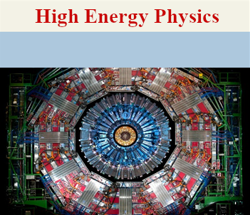
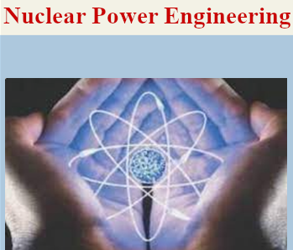
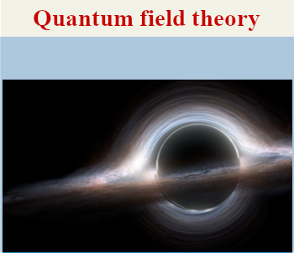
500 students
80 lecturers
140 researchers

Slide 2
EDUCATION
Master’s program “Physics of Nanosystems”
Selected courses:
Nanoelectronics
Physical properties of nanosystems
Theory and modelling of nanostructures
Physics of semiconductor heterostructures
Theory of nanocomposites
Physics of carbon nanocomposites
Modern problems in physics of nanosystems
Opportunities for students:
Various types of educational internships
Laboratory work
Participation in research projects
Academic mobility

Slide 3
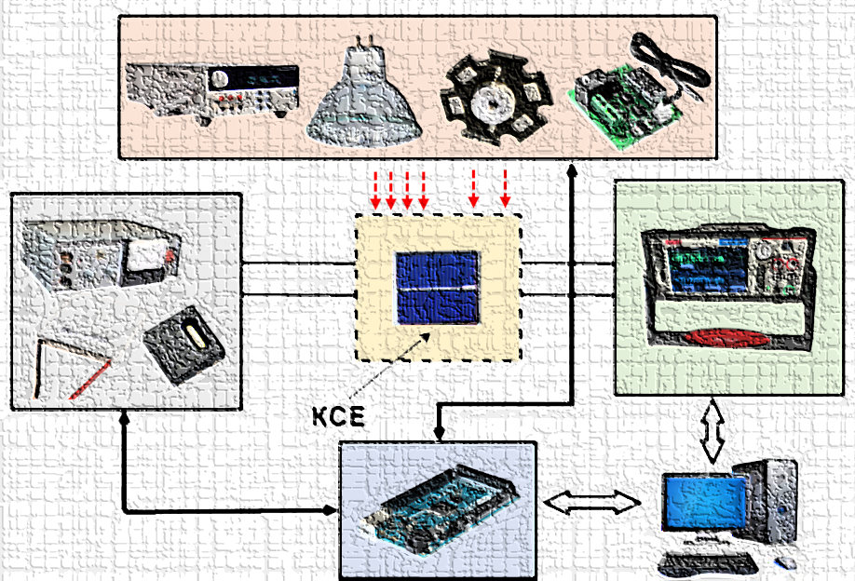
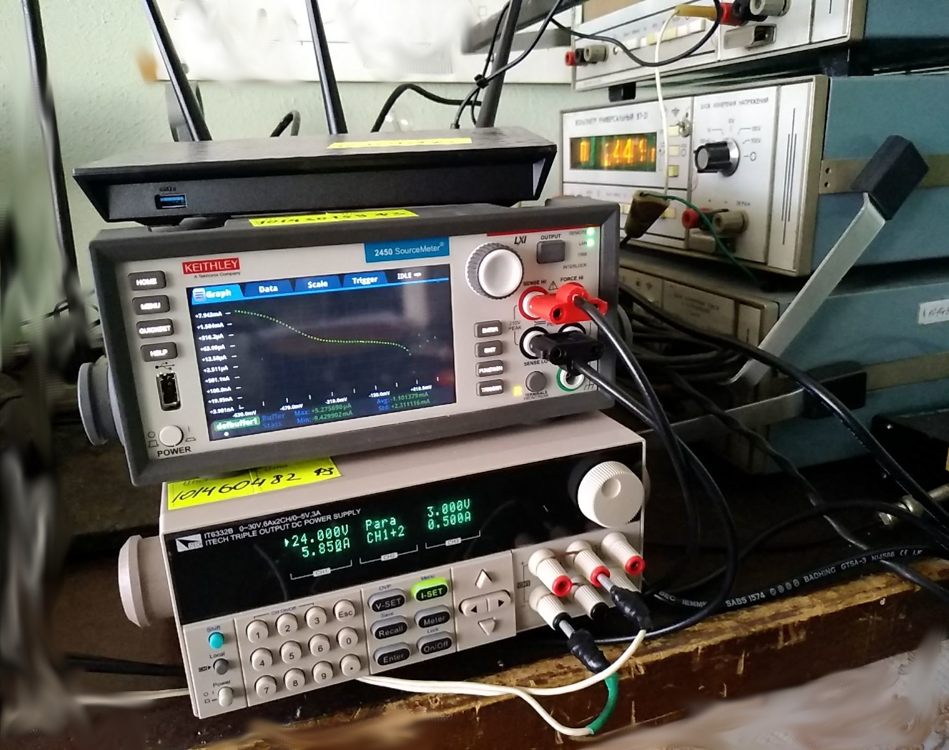
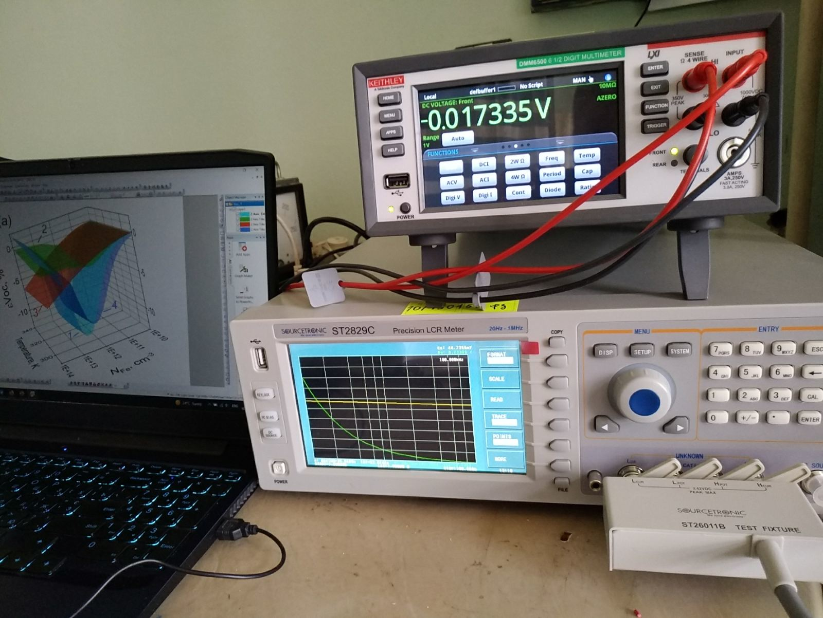
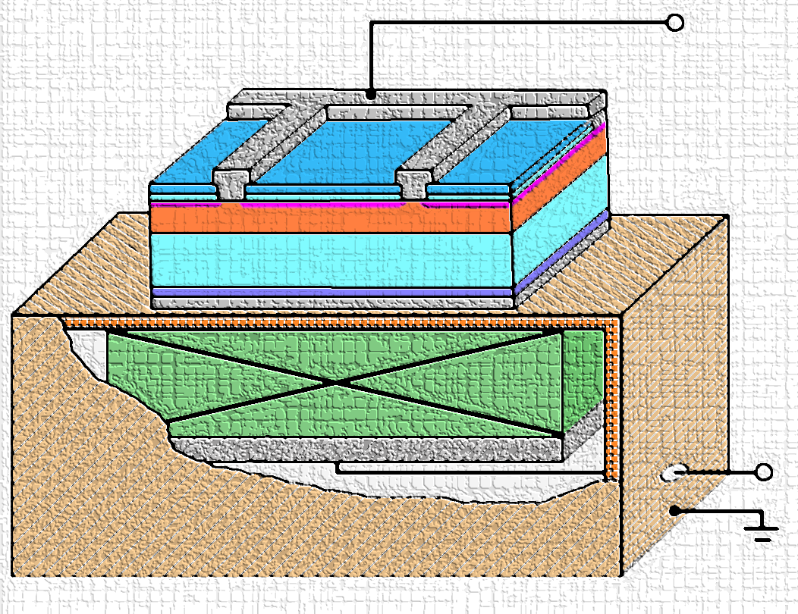
SCIENTIFIC RESEARCH
1. Experimental investigations of semiconductor structures for thermoelectrics and solar cells
Current-voltage measurement of solar cells (20 mV – 200 V, 10 nA – 1 A, 150 – 350 K)
Capacitance-voltage measurements of semiconductor barrier structures (20 Hz – 1MHz, 1fF – 10 F, 5mV – 10 V)
Determination of semiconductor structures’ parameters under ultrasound action (100 kHz – 30 MHz, transverse and longitudinal waves)

Slide 4
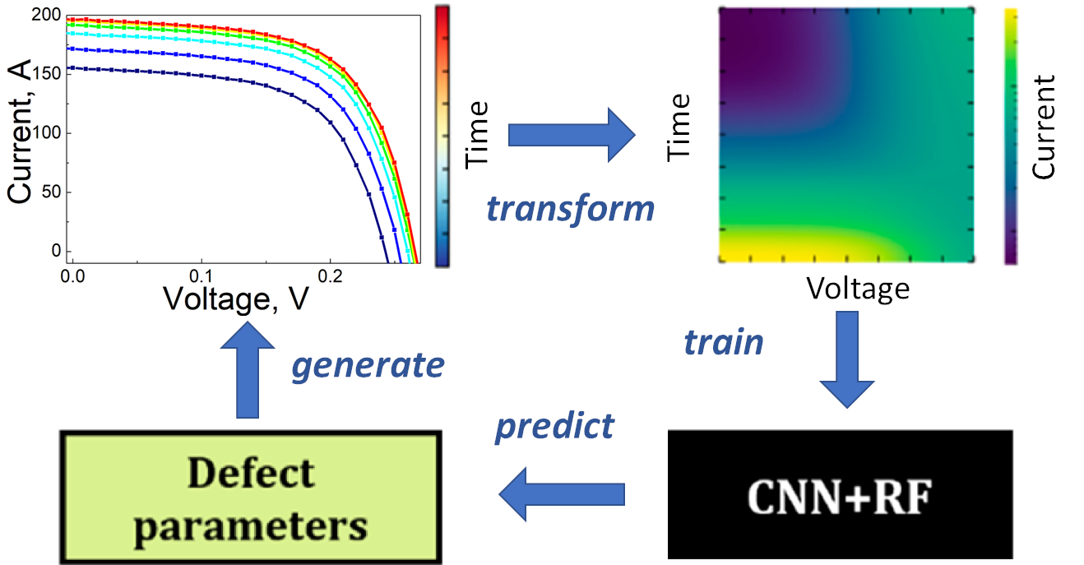
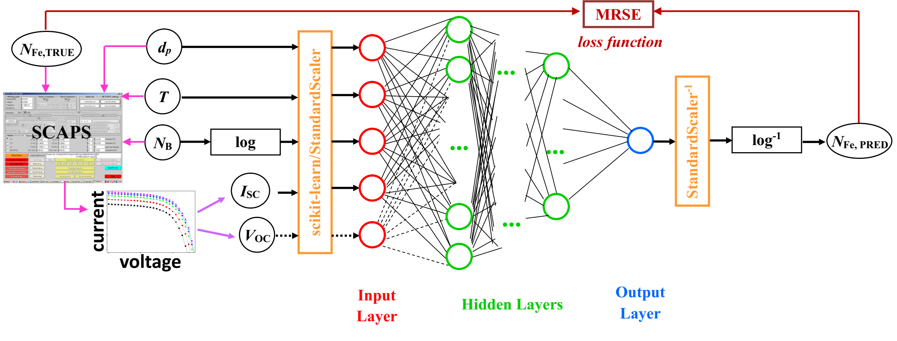
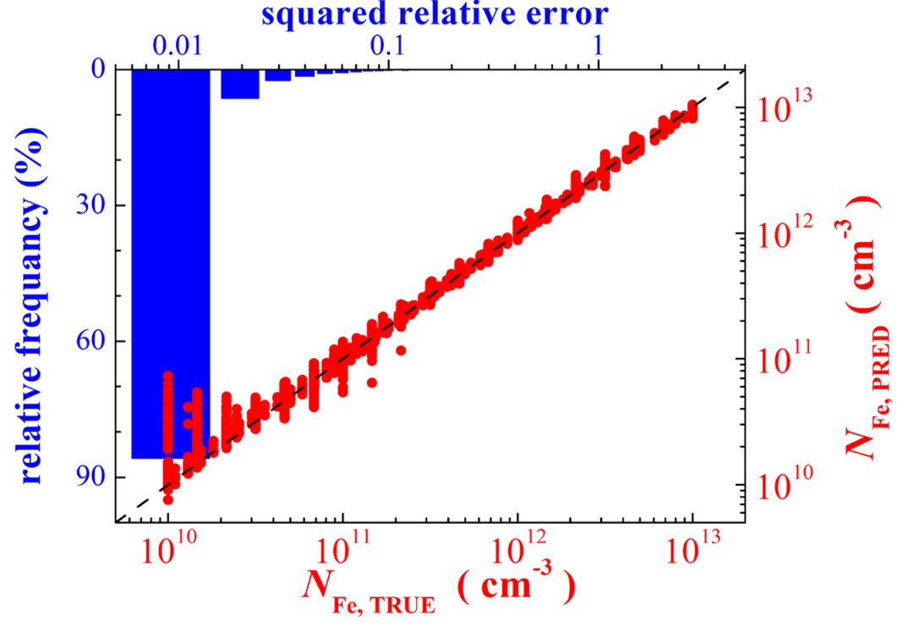
SCIENTIFIC RESEARCH
2. Using machine learning for estimation of defect contamination in solar cells
Simulation of photovoltaic structures for labeled dataset preparation
Exploring, teaching, and tunning machine learning algorithms
Testing of developed models on actual silicon solar cells

Slide 5
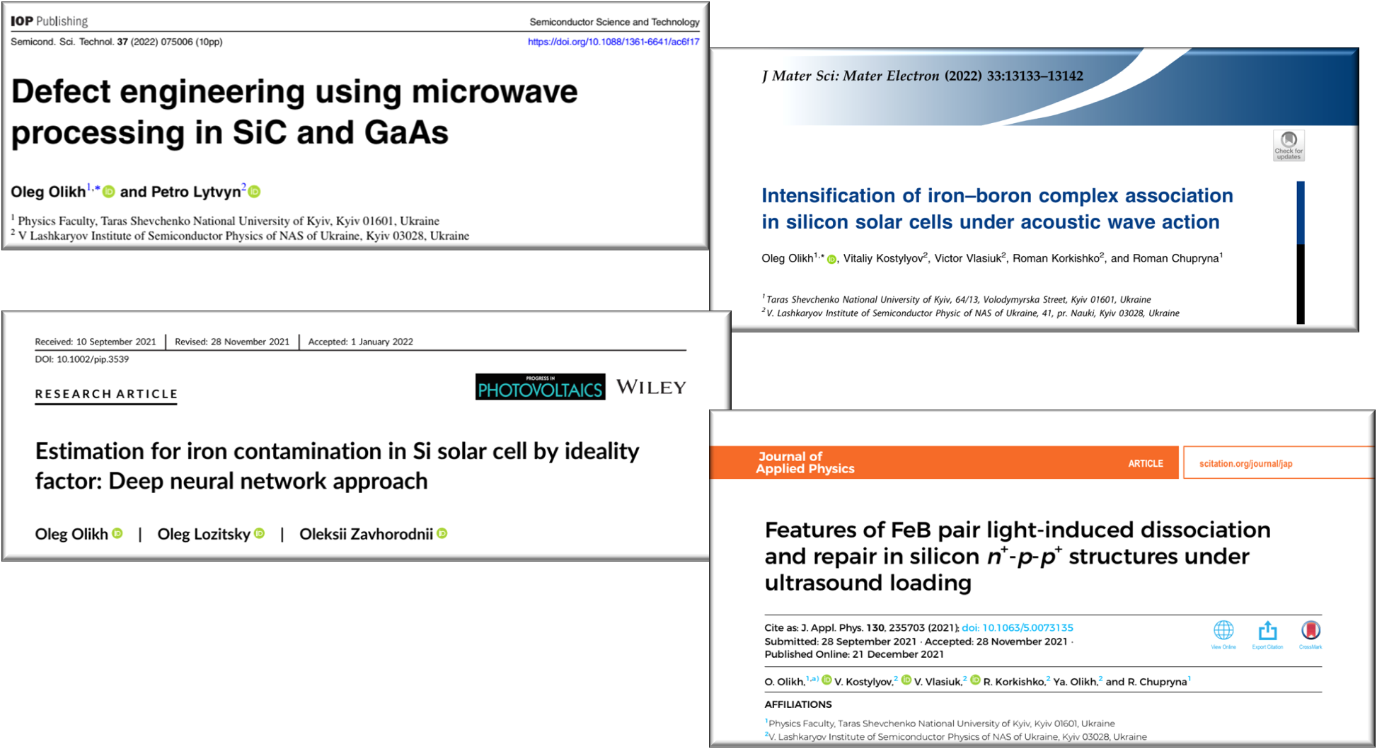

Slide 6
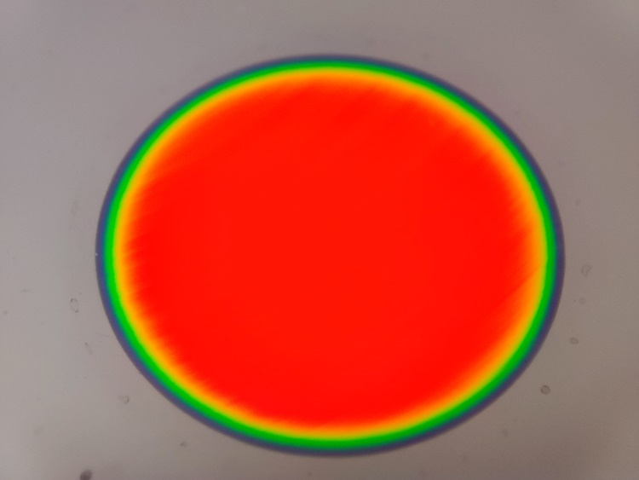
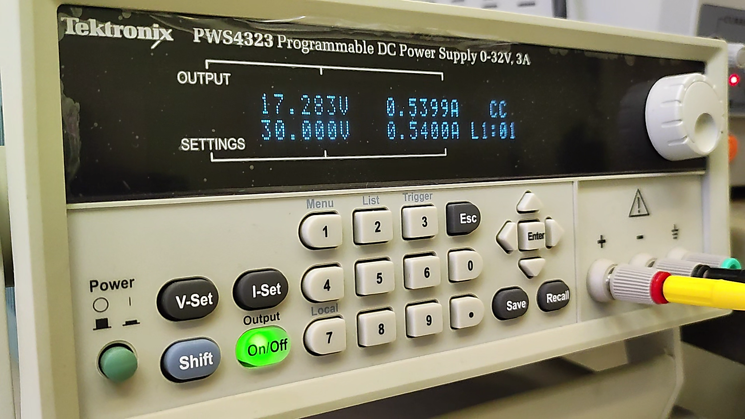
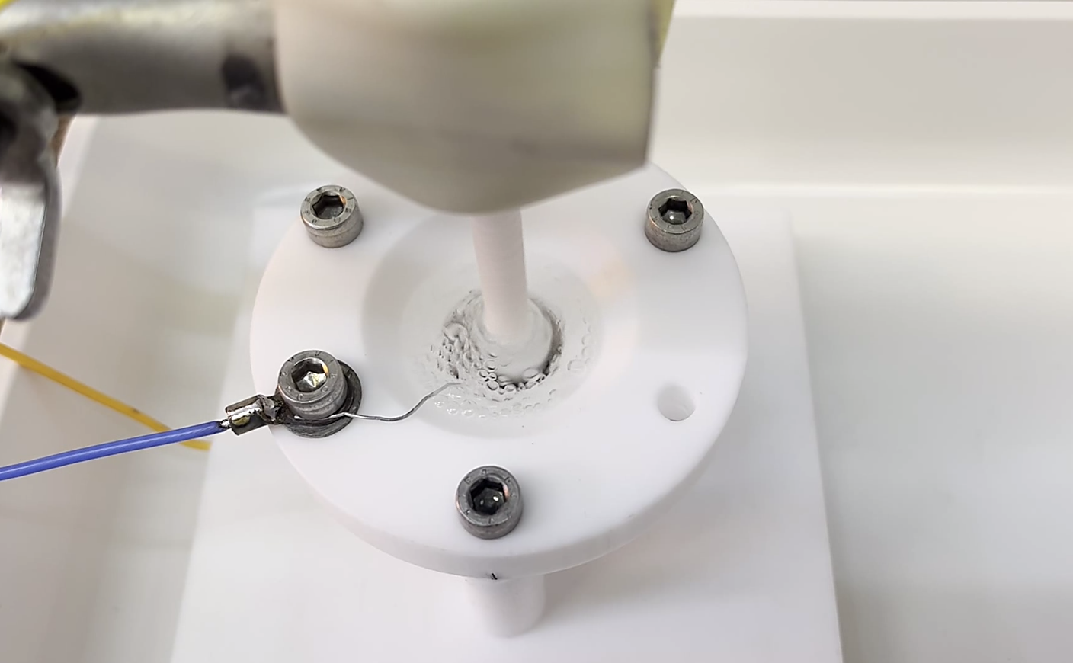
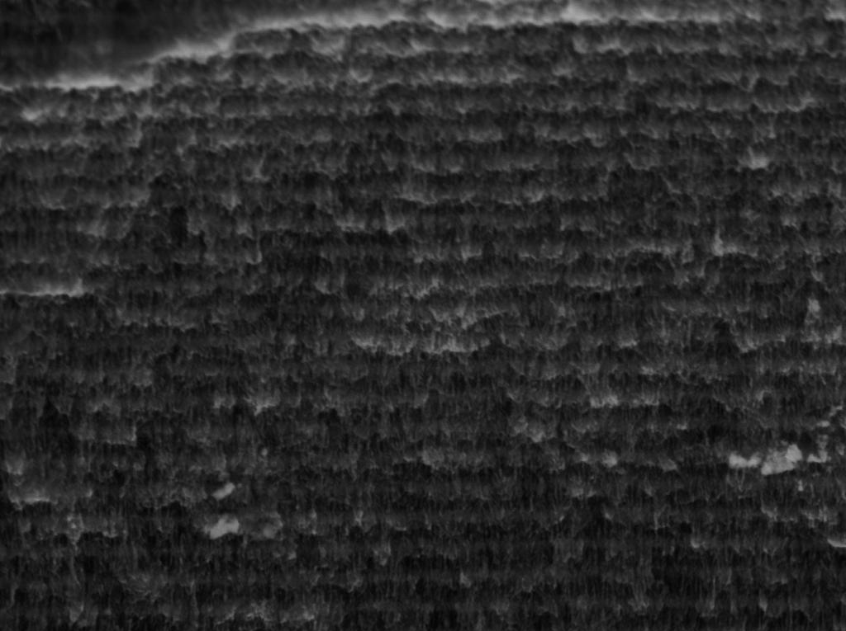
SCIENTIFIC RESEARCH
3. Synthesis of silicon multilayer porous structures and investigation of their structure, optical, and thermal properties
Electro-chemical etching of multilayer porous silicon
Gravimetry, Optical and scanning electron microscopy
Spectroscopic optical techniques

Slide 7
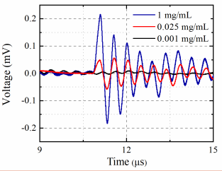
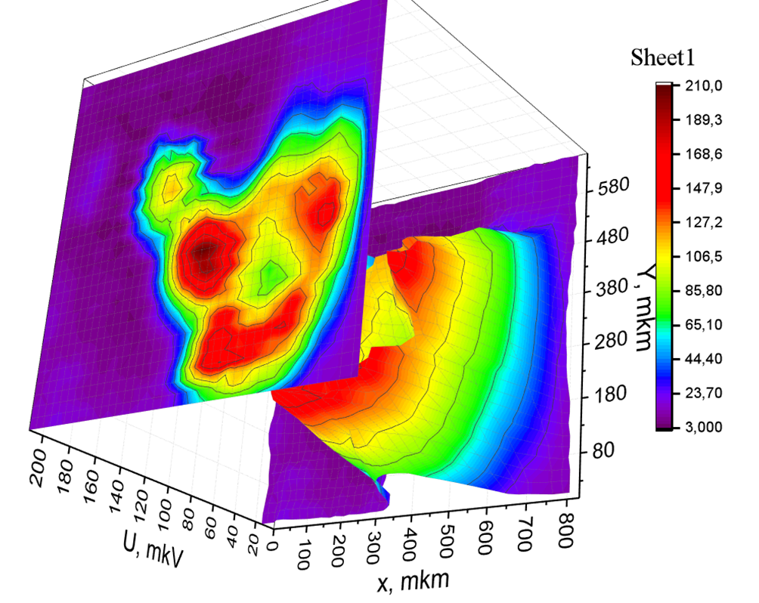
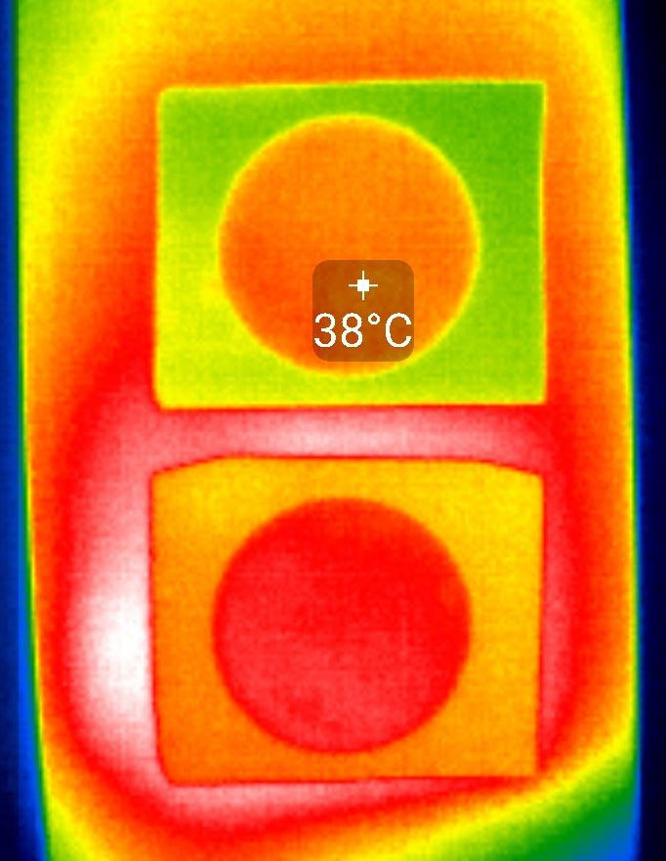
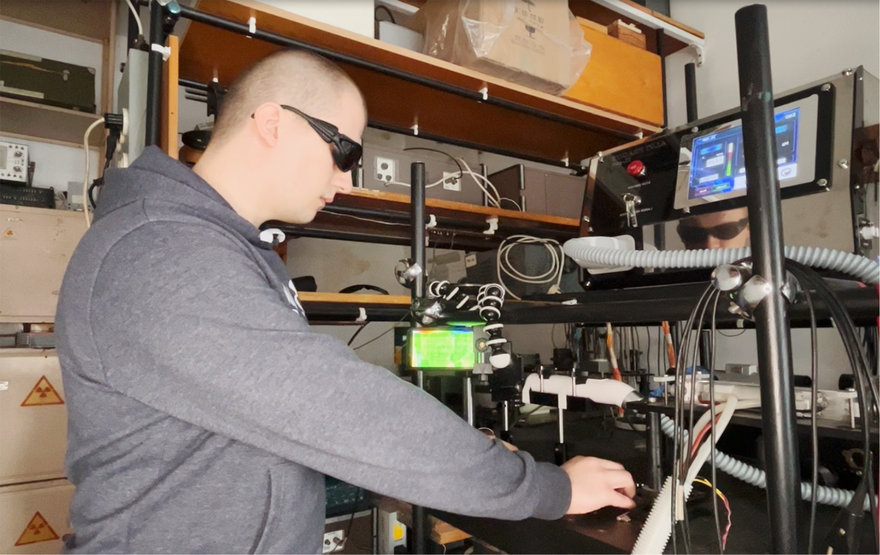
SCIENTIFIC RESEARCH
3. Synthesis of silicon multilayer porous structures and investigation of their structure, optical, and thermal properties
Photoacoustic and Photothermal techniques :
amplitude-frequency and phase-frequency responses
time and temperature dependent response of informative signal
photoacoustic and photothermal imaging
thermal diffusivity and thermal conductivity parameters

Slide 8
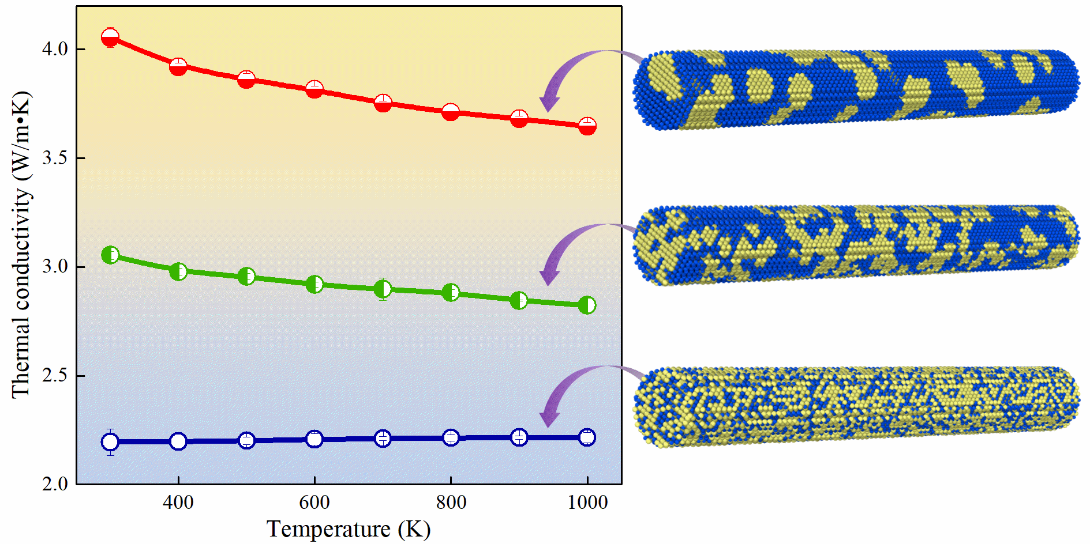
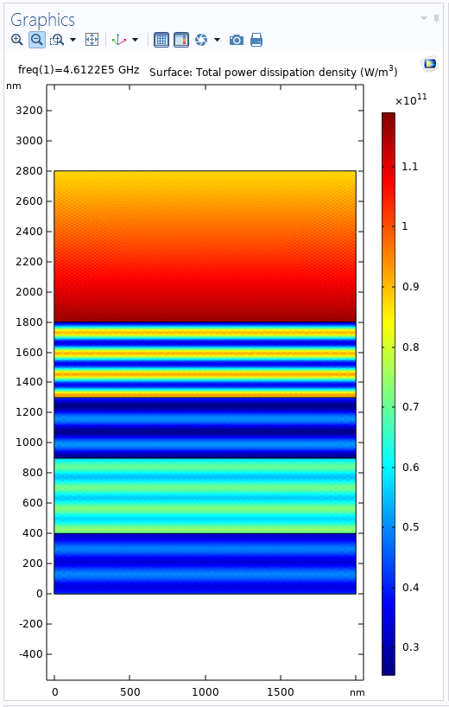
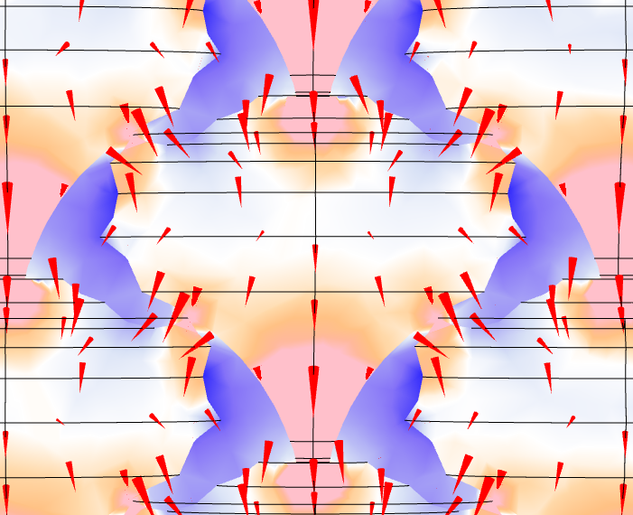
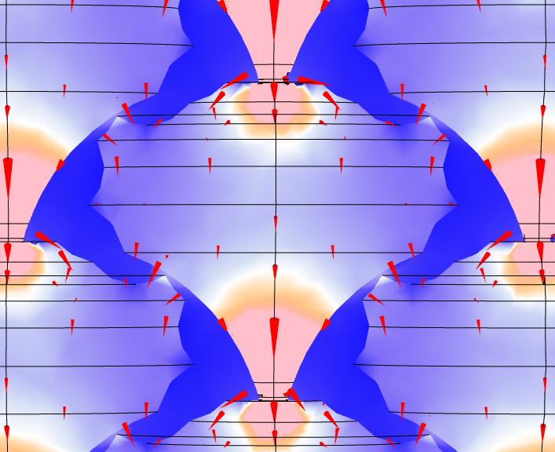
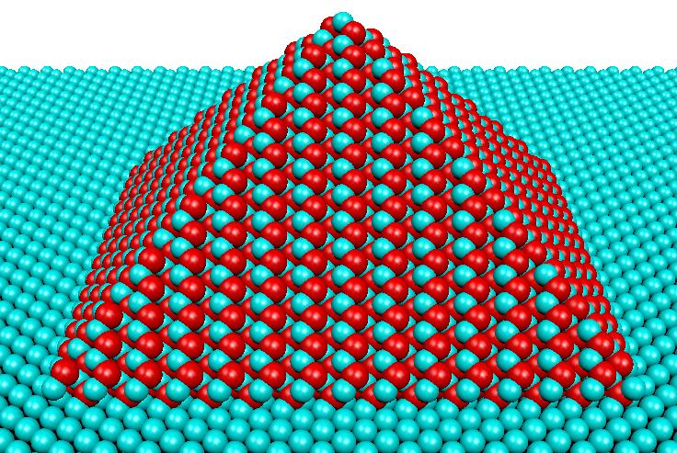
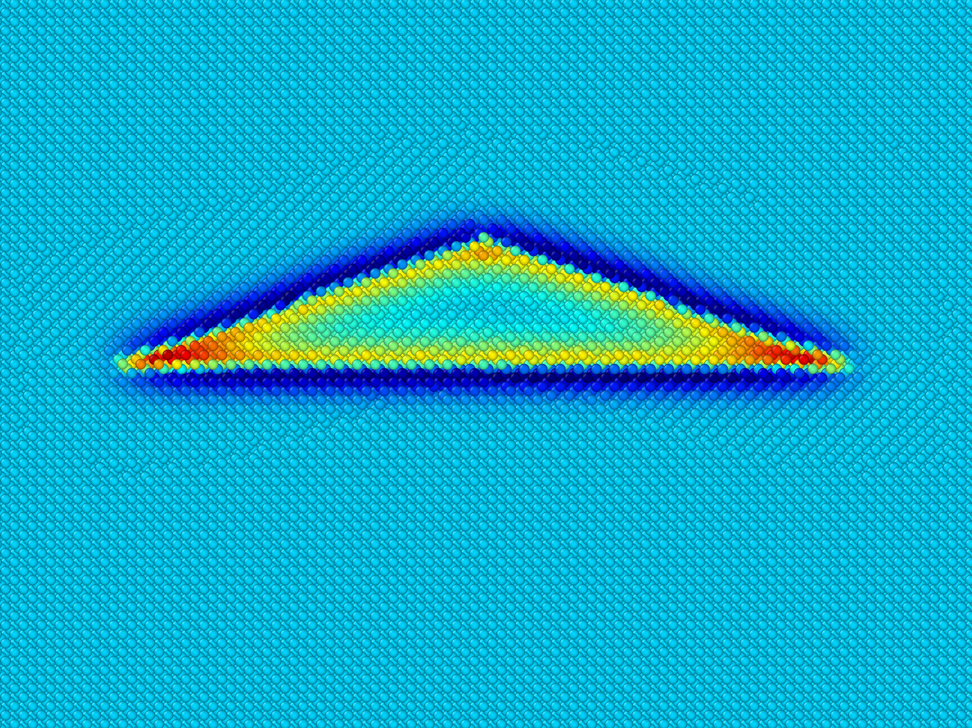
SCIENTIFIC RESEARCH
4. Modeling of phonon transport properties of nanostructures for thermal management and thermoelectric applications
Molecular dynamics simulation of thermal conductivity of semiconductor nanostructures
Anharmonic lattice dynamics
Analytical modeling of phonon transport in nanostructures
Finite element modeling of thermal phenomena in materials

Slide 9
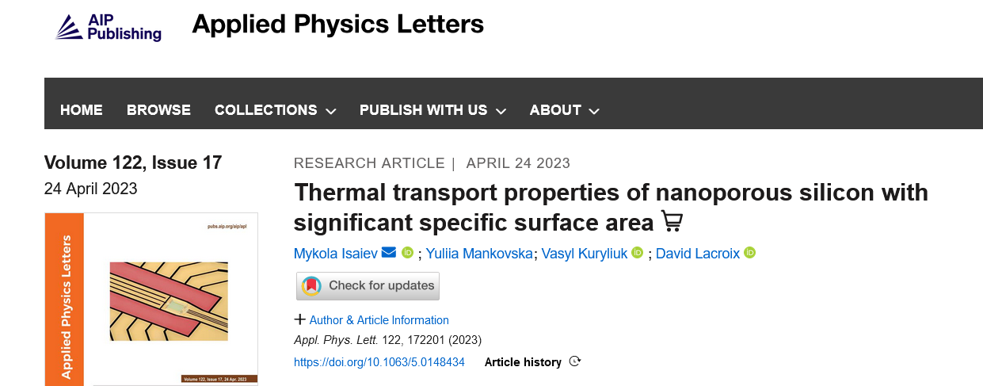
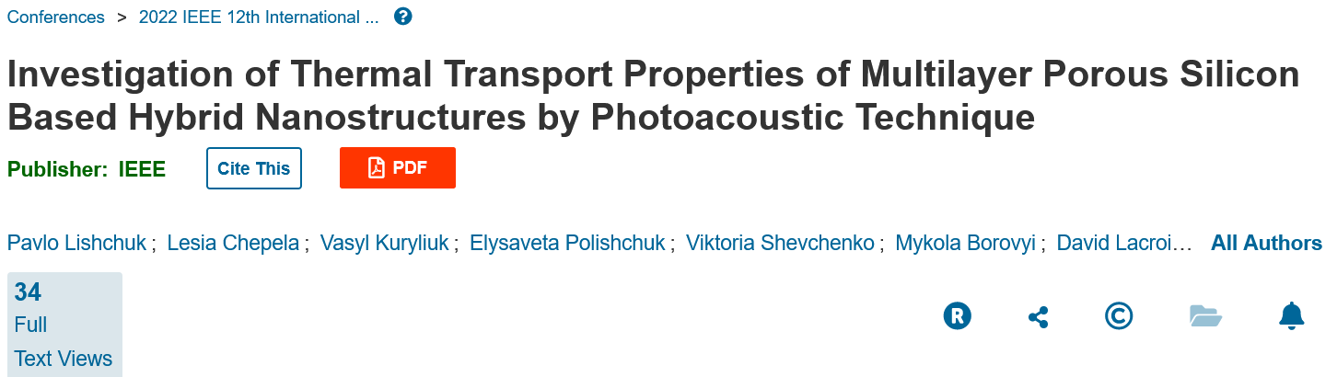
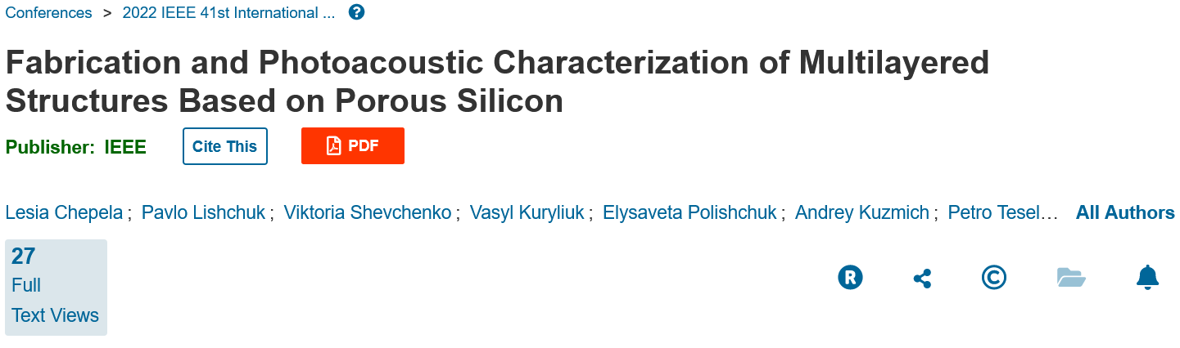
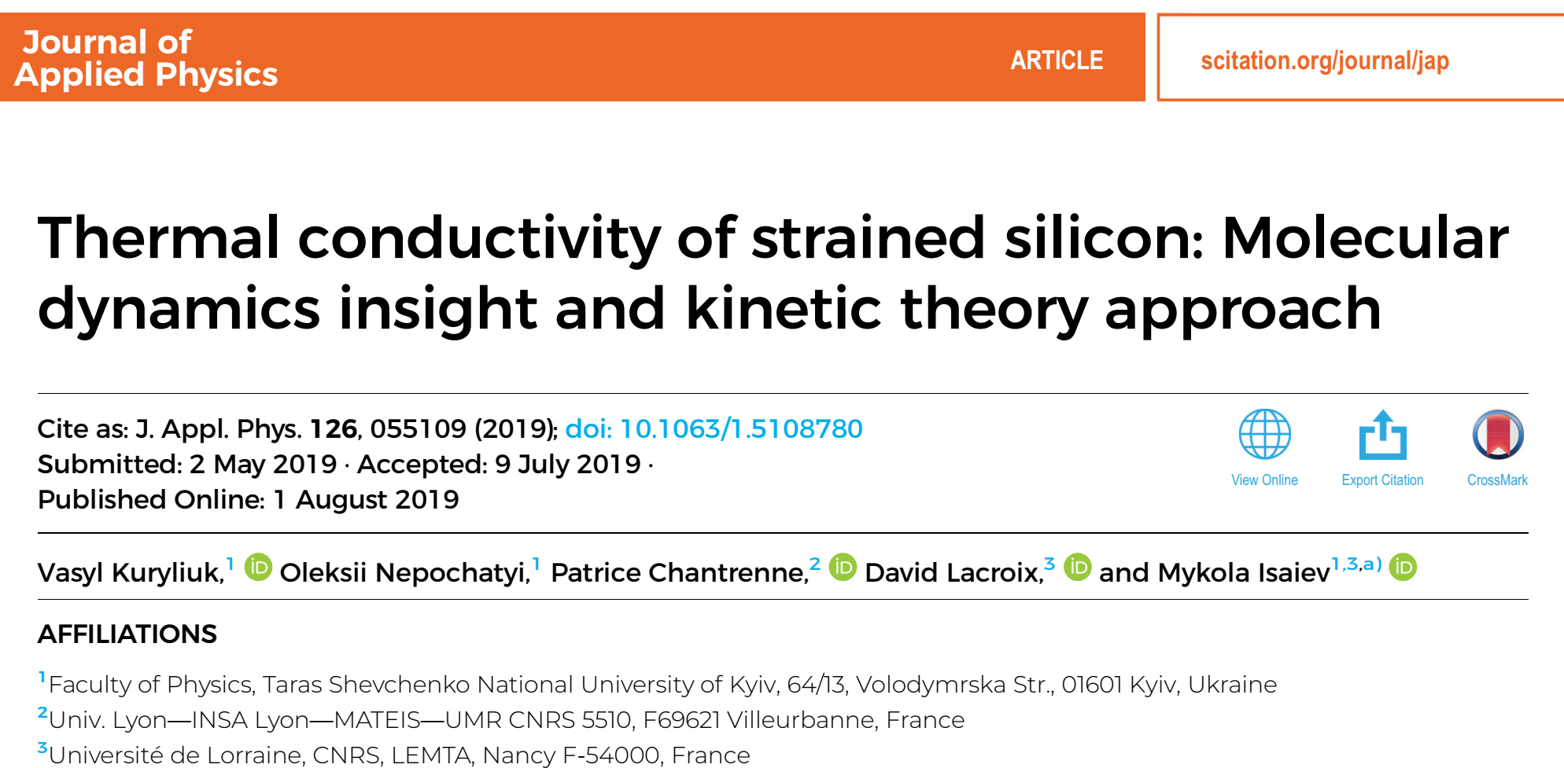

Slide 10
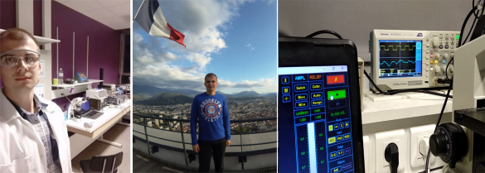
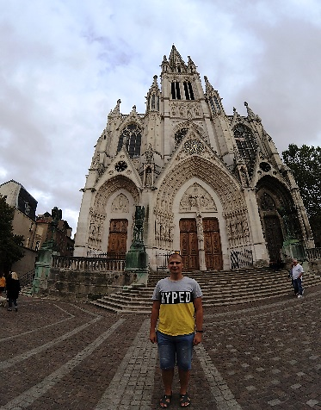
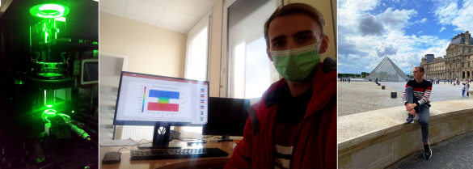
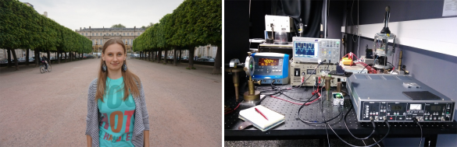
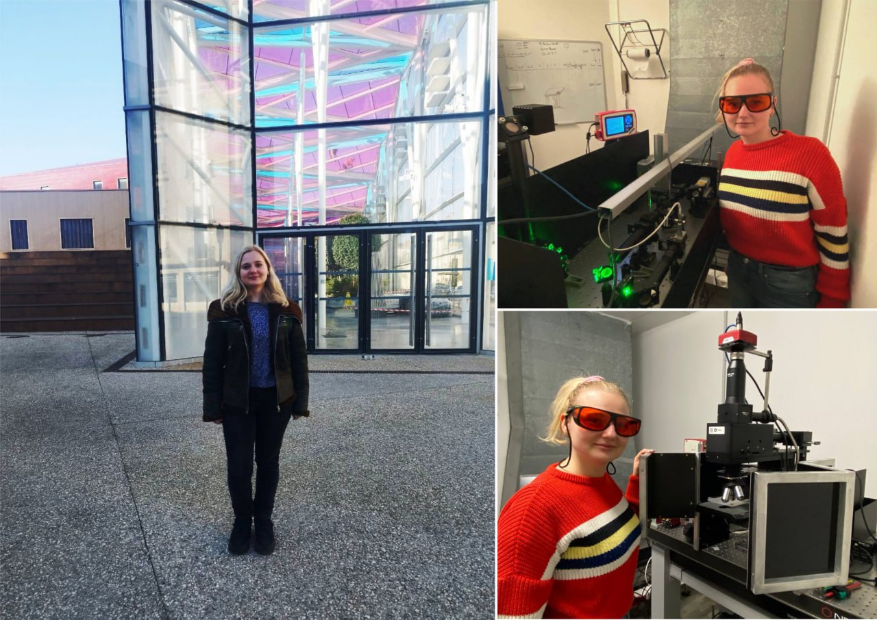
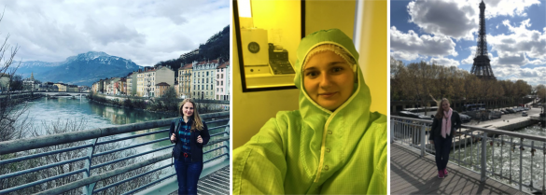
EXCHANGE OF SCIENTIFIC EXPERIENCE
PAVLO LISHCHUK: joint experimental research on thermal transport in semiconductor structures (2017-2019).
VIKTOR MANDROLKO during academic mobility within the Erasmus+ program (2021-2022)
KATERYNA DUBYK: experimental research on colloidal solutions of nanoparticles with varying content of carbon materials (2016, 2017).
LESIA CHEPELA during academic mobility within the Erasmus+ program (2019, 2023).

